Slide 1

Ecological Factors Associated with Self-Reported Mental Health Status: Option B
Alyssa Berger, Andrew Cistola
Midterm Project Proposal
PHC6194

Slide 2
Project Description and Rationale
Ecological factors such as socioeconomic status and health resource availability are known, relevant predictors of many health outcomes
However, the scope of research spatially identifying these factors in relation to mental health is relatively limited
There are many possible effects and interactions among these ecological factors and specific mental health conditions that have not been identified
Identifying which ecological factors are most influential in predicting mental health status would be vital information for preventative and targeted interventions

Slide 3
Specific Aims and Objectives
1. Identify local socioeconomic factors associated with a higher prevalence of poor self-reported mental health status
2. Identify area health resources that are associated with a lower prevalence poor mental health

Slide 4
Approach/Research Design Specific Aim 1
1. Collect estimated zip code level self-reported poor mental health status as percent of population from the 2020 release of the CDC and RWJF PLACES dataset (formerly 500 Cities project). This represents the outcome of interest.
2. Collect approximately 400 zip code level socio-economic variables as percent estimates in the detailed profile tables from the 2020 release of the US Census American Community Survey. These represent the possible predictors.
4. Utilize open-source machine learning algorithms to identify variables with both high variation and high importance. Conduct cross-validated prediction to identify the smallest number of variables that will achieve the bets fitting model.
5. Use an artificial neural network with backwards propagation to predict zip codes in top quartile. Compare the predictive capability using (AUC test) all predictors, a random set of predictors, other known predictors (Neighborhood Deprivation Index), and the variables obtained in step 4.
3. Connect outcomes with predictors, remove observations with missing values, impute missing data for predictor variables using median values, standard scale all variables.
6. Remove variables that are not consistent with any current theoretical construct test for OLS assumptions. Use domain knowledge to develop an appropriate mixed effects regression model for the purpose of identifying parameter estimates.

Slide 5
Approach/Research Design Specific Aim 2
1
2
3
4
Using local Empirical Bayes smoothing and LISA quadrants, identify ‘hot and cold spot’ regions and assign nominal labels to contained counties. Use algorithms capable of multi-nomial prediction to identify health resources associated with each category.
5
Using zip code predictors, conduct geographic weighted regression to identify regions each predictor has significantly higher or lower coefficients. Assign nominal labels and use algorithms capable of multi-nomial prediction to identify health resources associated with each category.
6
Using domain knowledge create lists using the selected county variables associated with increased or decreased prevalence given the assumptions in step 4 and 5. Remove variables that are not consistent with any current theoretical construct and test for OLS assumptions.
7
For each county predictor create adjusted mixed-effects regression adjusting for zip code predictors that include the county predictor as an independent parameter (LISA) or as an interaction term (GWR). Compare statistically significant parameters estimates.
Collect estimated zip code level self-reported poor mental health status as percent of population from the 2020 release of the CDC and RWJF PLACES dataset (formerly 500 Cities project). This represents the outcome of interest.
Collect approximately 2000 county level health resource variables from the 2020 release of the HRSA Area Health resource File. These represent possible predictors.
Connect outcomes with predictors, remove observations with missing values, impute missing data for predictor variables using median values, standard scale all variables.

Slide 6
Timeline
Our group has been meeting weekly to discuss project ideas and collaborate since January 29th, 2021
Current work at https://github.com/andrewcistola/PHC6194 (private)
Preliminary results available for steps 1-5 of specific aim 1 and step 1-4 of specific aim 2
January-March:
Finalize project ideas and proposal
March 22nd-April 9^{th:}
Conduct analysis
April 9th-April 23rd: Interpret Results and Finalize Report

Slide 8
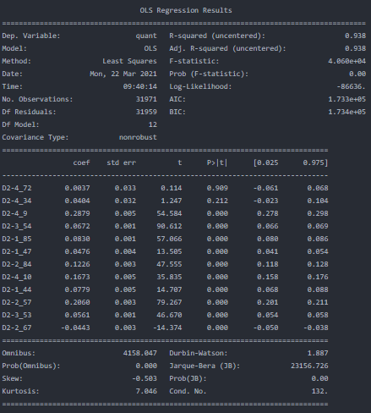
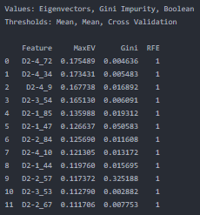
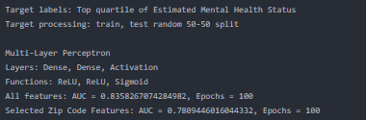
https://github.com/andrewcistola/PHC6194

Slide 9
References
Forthman KL, Colaizzi JM, Yeh H-w, Kuplicki R, Paulus MP. Latent Variables Quantifying Neighborhood Characteristics and Their Associations with Poor Mental Health. International Journal of Environmental Research and Public Health. 2021; 18(3):1202. https://doi.org/10.3390/ijerph18031202.
Eibich P, Krekel C, Demuth I, Wagner GG. Associations between Neighborhood Characteristics, Well-Being and Health Vary over the Life Course. Gerontology 2016; 62: 362–370.
Miles JN, Weden MM, Lavery D, Escarce JJ, Cagney KA, Shih RA. Constructing a Time-Invariant Measure of the Socio-economic Status of U.S. Census Tracts. J. Urban Health 2016; 93: 213–232.

